Slide 1



AI-Powered Dynamic Pacman
Author: Laiba Bint-e-Zia
Date: 12th.05.2025

Slide 2

CONTENTS
1. Introduction
2. Project Objectives
3. Game Features and Mechanics
4. AI Methodology
5. Challenges Faced
6. Results & Performance
7. Technologies Used
8. Conclusion
9. Visual Theme

Slide 3

01
Introduction

Slide 4
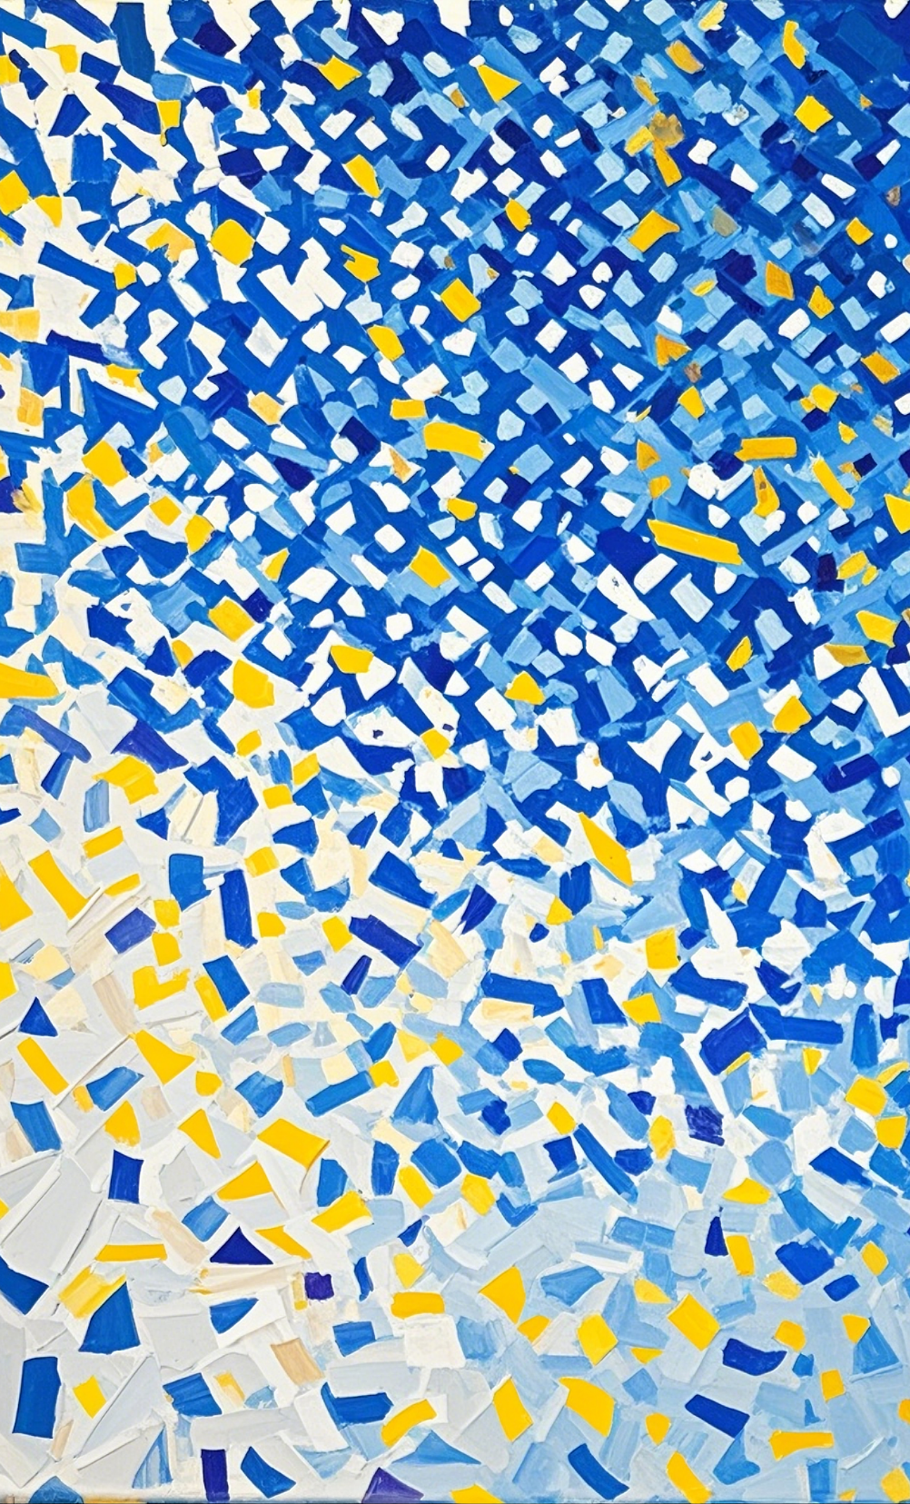

Introduction
1
Original Pacman Game
•In traditional Pacman, the player navigates a maze to consume all pellets while avoiding capture by four ghosts. Power pellets allow Pacman to eat ghosts temporarily. The goal is to clear the map without losing all lives.
2
Motivation for Upgrading
•The goal was to blend nostalgia with modern AI techniques in a fun, multiplayer setting.
Using pathfinding algorithms and procedural maps, we created a smarter, more competitive experience.

Slide 5

02
Project Objectives

Slide 6



Project Objectives
2
AI-based ghost behavior
Two-player competition
1
3
Dynamic map

Slide 7

03
Game Features and Mechanics

Slide 8




Game Features and Mechanics
Map regeneration
1
2
Scoring
Power-ups
4
3
Respawning

Slide 9

04
AI Methodology

Slide 10



AI Methodology
Use of Genetic Algorithm to optimize the chasing
Use of DFS (Depth-First Search)
Use of A* for ghost pathfinding and goal tracking

Slide 11

05
Challenges Faced

Slide 12

Challenges Faced
1
Training Ghost on algorithms to chase the Pacmen(they had been acting up throughout the whole process)
2
Real-time dynamic maze building

Slide 13

06
Results & Performance

Slide 14
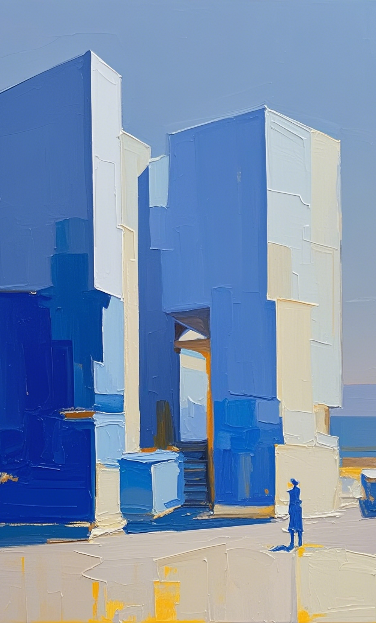
Results & Performance
1
Ghost AI demonstrated the ability to adapt and pursue player
2
Map regeneration within the game loop
3
Two player Pacman

Slide 15

07
Technologies Used

Slide 16
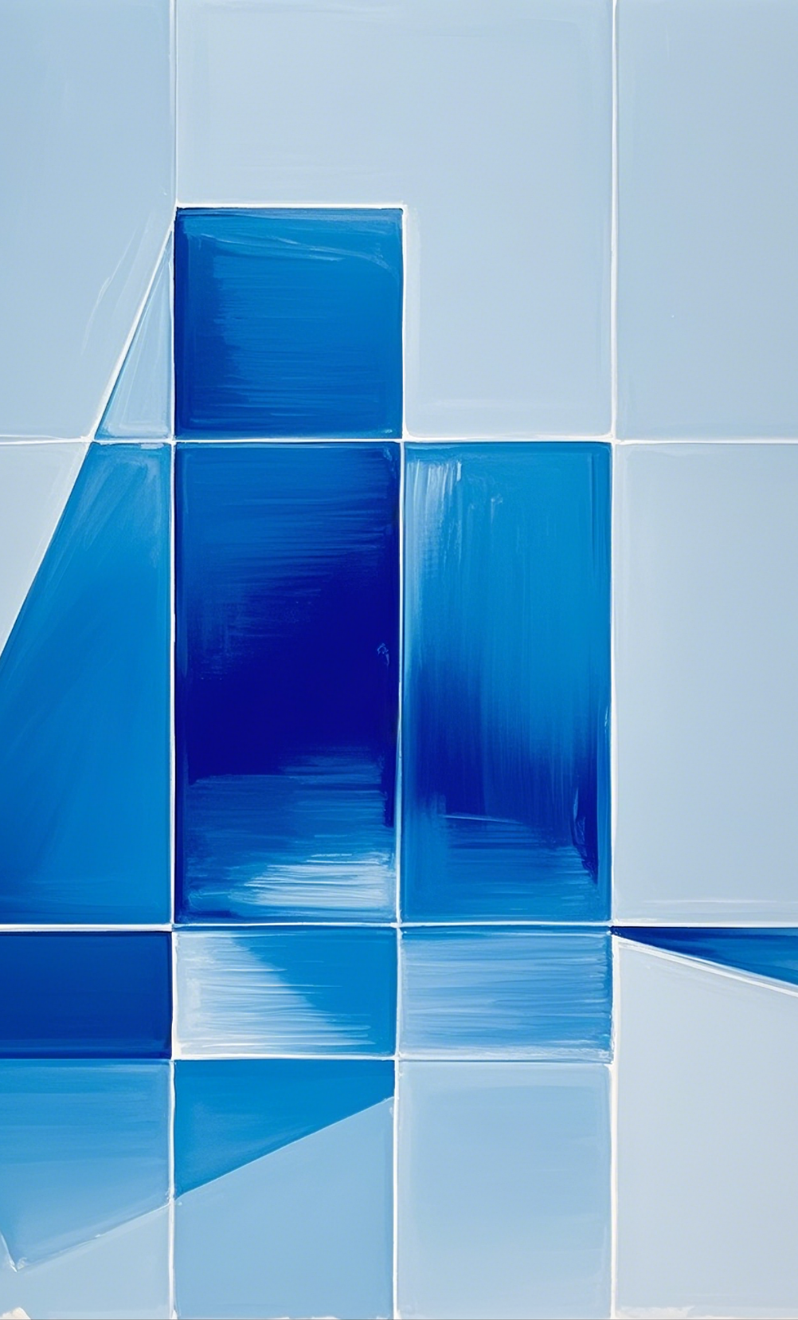

Technologies Used
Python
Pygame
Online Resources

Slide 17
08
Conclusion

Slide 18
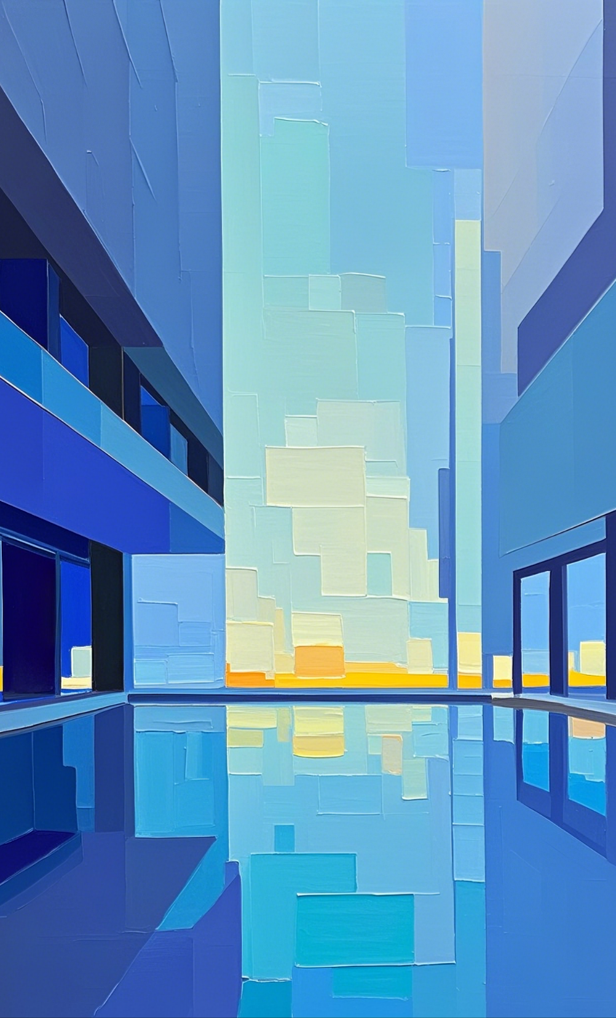
Conclusion
This project successfully transformed the traditional Pacman game into a dynamic, AI-driven experience. By integrating intelligent ghost behavior using search algorithms and introducing multiplayer mechanics with a regenerating map, we created a challenging and engaging game environment. The combination of classic gameplay with modern AI not only enhanced the player experience but also demonstrated the power of AI in real-time decision-making and adaptive systems.

Slide 19

Thank You

